Slide 1


BIT07 – Machine Learning
Cedric Hermans

Slide 2
Neural networks

Slide 3
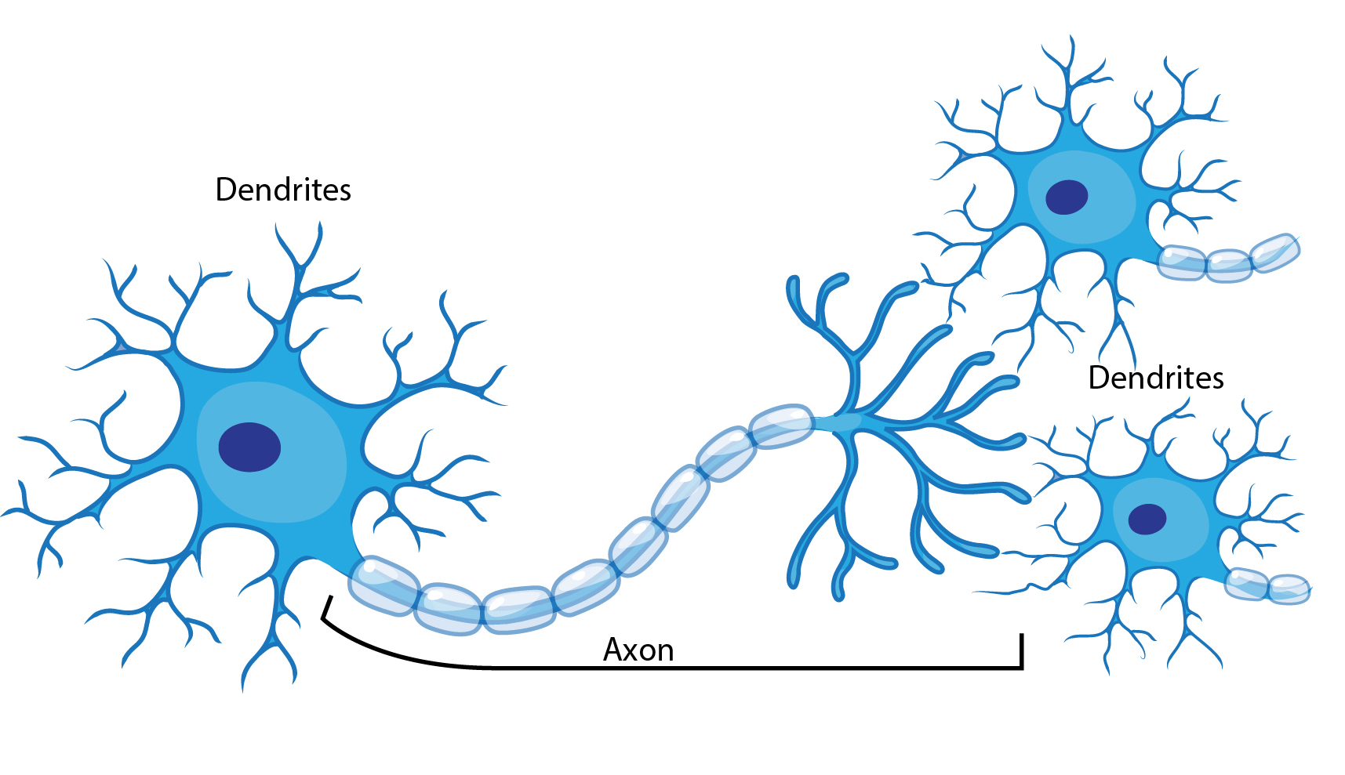
What is a neural network?
Definition
Neural networks, also known as artificial neural networks (ANNs) or simulated neural networks (SNNs), are a subset of machine learning and are at the heart of deep learning algorithms. Their name and structure are inspired by the human brain, mimicking the way that biological neurons signal to one another.

Slide 4
What is a neural network?
Definition
Neural networks, also known as artificial neural networks (ANNs) or simulated neural networks (SNNs), are a subset of machine learning and are at the heart of deep learning algorithms. Their name and structure are inspired by the human brain, mimicking the way that biological neurons signal to one another.

Slide 5
What is a neural network?
Knowledge is acquired through a learning process
Interneuron connection strengths known as synaptic weights are used to store knowledge
Weight 1
Weight 2

Slide 6

What is a neural network?
Inspired on the brain:
The human brain is very good in tasks like pattern recognition, speech recognition, perception…
As the brain gets more information, it learns faster
Very good in parallel processing
Classical computer: in series (one at a time)

Slide 7
What is a neural network?
A comparison

Slide 8
Artificial neural network
Perceptron
Inputs
X₁
Weight 1
X₂
Weight 2
Perceptron
Weight …
…
Weight n
X_{n}

Slide 9
Artificial neural network
Perceptron
Inputs
X₁
Perceptron
W₁
X₂
Transfer function
Activation function
W₂
∑
φ
W…
Activation
…
W_{n}
Bias
Threshold
X_{n}

Slide 10
Artificial neural network
Perceptron
Inputs
X₁3
Perceptron
W₁ 0,2
Transfer function
Activation function
X₂1
W₂ 0,4
∑: summing function: µ=w₁x₁+ w₂x₂+w₃x₃+b
=0,2*3+0,4*1+0,1*2+0
=1,2
φ
Activation
W₃ 0,1
b: 0
Threshold
X₃2

Slide 11
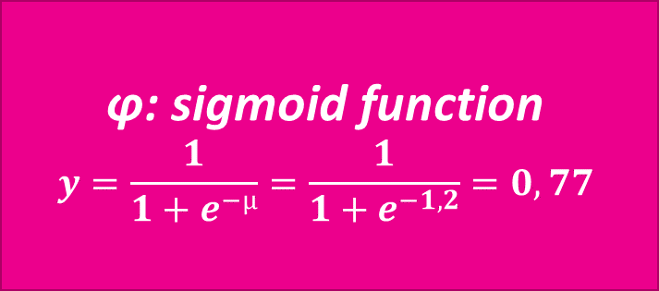
Artificial neural network
Perceptron
Inputs
X₁3
Perceptron
W₁ 0,2
Activation function
Transfer function
φ: sigmoid function
$$y=\frac{1}{1+e^{−µ}}=\frac{1}{1+e^{−1,2}}=0,77$$
X₂1
W₂ 0,4
∑
Activation
W₃ 0,1
b: 0
Threshold
X₃2

Slide 12
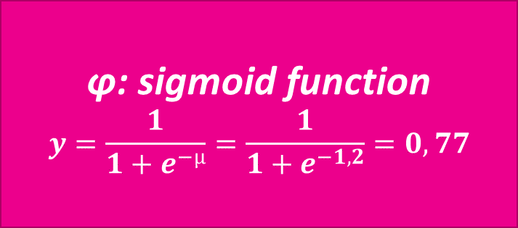
Artificial neural network
Perceptron
Inputs
X₁3
Perceptron
W₁ 0,2
Activation function
Transfer function
φ: sigmoid function
$$y=\frac{1}{1+e^{−µ}}=\frac{1}{1+e^{−1,2}}=0,77$$
X₂1
W₂ 0,4
∑
Activation
1
W₃ 0,1
b: 0
Threshold: 1 if y>=0,5 else 0
X₃2

Slide 13
Artificial neural network
Characteristics
Architecture
Learning algorithm
Activation functions

Slide 14

Artificial neural network
Architectures

Slide 15
Feedforward neural network
Hidden layer
Input layer
Output layer
Perceptron

Slide 16
Feedforward neural network
Hidden layer
Input layer
Output layer

Slide 17
Deep feedforward neural network
Hidden layer 1
Hidden layer 2
Input layer
Output layer

Slide 18
Feedforward neural network
XOR example
XOR:
Impossible to do with a linear network
Input 2
Input 1 | Input 2 | Output
0 | 0 | 0
0 | 1 | 1
1 | 0 | 1
1 | 1 | 0
1
Input 1
1

Slide 19
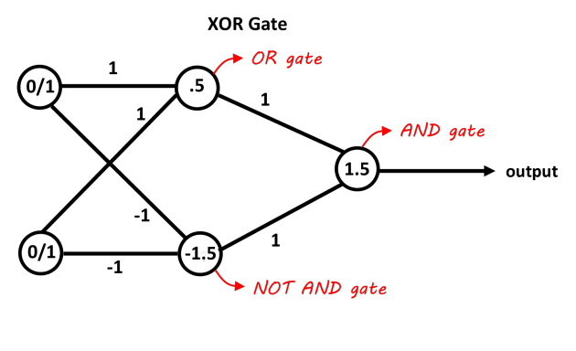
Feedforward neural network
XOR example
XOR:
Input 1 | Input 2 | Output
0 | 0 | 0
0 | 1 | 1
1 | 0 | 1
1 | 1 | 0

Slide 20
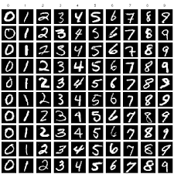
Feedforward neural network
MNIST
Each image: 28x28
=> 784 features
# Input neurons = # features
# Output neurons = # classes
MNIST: 10 numbers => 10 output neurons

Slide 21
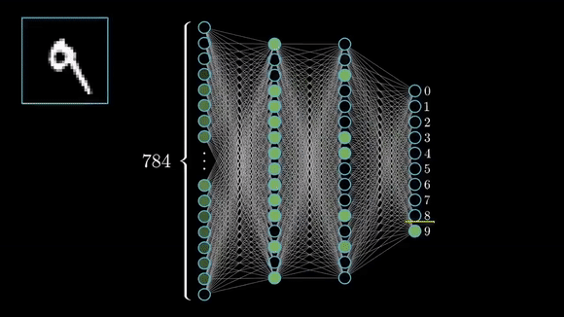
Feedforward neural network
MNIST
Each image: 28x28
=> 784 features
# Input neurons = # features
# Output neurons = # classes
MNIST: 10 numbers => 10 output neurons

Slide 22
Feedforward neural network
The output layer of neural networks for classification exists out of X neurons where X is the number of possible classes
To train the model, we compare the output of the model with the expected output.
One-hot encoded target vectors
For MNIST:
Class: 0,1,2,3,4,5,6,7,8,9
If label = 0: [1,0,0,0,0,0,0,0,0,0]
If label = 3: [0,0,0,1,0,0,0,0,0,0]
If label = 7: [0,0,0,0,0,0,0,1,0,0]

Slide 23
Feedforward neural network
Training a neural network is done via backpropagation
Look at the desired output and compare this with the predicted output
Based on this: adjust the weights in the neural network

Slide 24
Feedforward neural network
Backpropagation – a simplified example
Input layer
Output layer
Expected
0,8
0
1
0
0
0,4
0,2
0,0

Slide 25
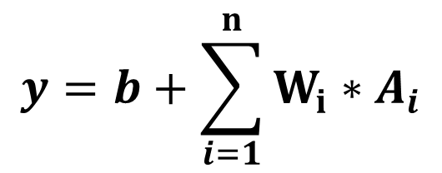
Feedforward neural network
Backpropagation – a simplified example
hidden layer (h)
Input layer
W₁ * h₁
Output layer
Expected
h1
0,8
0
1
0
0
h2
0,4
h3
0,2
h4
0,0
h5
$$y=b+\sum_{i=1}^{n}{W_{i}∗A_{i}}$$

Slide 26
Feedforward neural network
Backpropagation – a simplified example
Green: positive value
Red: negative value
Increase output by:
Increasing bias
Increase green values
Increase weights
Increase h-values (output previous layer)
Decrease red values
Decrease weights
Decrease h-values (output previous layer)
hidden layer (h)
Input layer
W_{1,2} * h₁
Output layer
Expected
h1
0,8
0
1
0
0
h2
0,4
h3
0,2
h4
0,0
h5
$$y=b+\sum_{i=1}^{n}{W_{i}∗A_{i}}$$

Slide 27
Feedforward neural network
Backpropagation – a simplified example
Green: positive value
Red: negative value
Decrease output by:
Lowering bias
Decrease green values
Decrease weights
Decrease h-values (output previous layer)
Increase red values
Increase weights
Increase h-values (output previous layer)
hidden layer (h)
Input layer
W_{1,1} * h₁
Output layer
Expected
h1
0,8
0
1
0
0
h2
0,4
h3
0,2
h4
0,0
h5
$$y=b+\sum_{i=1}^{n}{W_{i}∗A_{i}}$$

Slide 28
Feedforward neural network
Backpropagation – a simplified example
Changing bias
Raise or lower
Changing weights
Raise or lower
Changing h-values
Can’t be done directly
h-value is output from previous layer
hidden layer (h)
Input layer
W_{1,1} * h₁
Output layer
Expected
h1
0,8
0
1
0
0
h2
0,4
h3
0,2
h4
0,0
h5
$$y=b+\sum_{i=1}^{n}{W_{i}∗A_{i}}$$

Slide 29
Feedforward neural network
Backpropagation – a simplified example
Changing h-values = updating the weights and values that create this value
hidden layer (h)
Input layer
W_{1,1} * h₁
Output layer
Expected
h1
0,8
0
1
0
0
h2
0,4
h3
0,2
h4
0,0
h5
$$y=b+\sum_{i=1}^{n}{W_{i}∗A_{i}}$$

Slide 30
Feedforward neural network
Backpropagation
Don’t apply the entire error, but use a learning rate η
The math is quite complex
More information https://medium.com/@14prakash/back-propagation-is-very-simple-who-made-it-complicated-97b794c97e5c

Slide 31
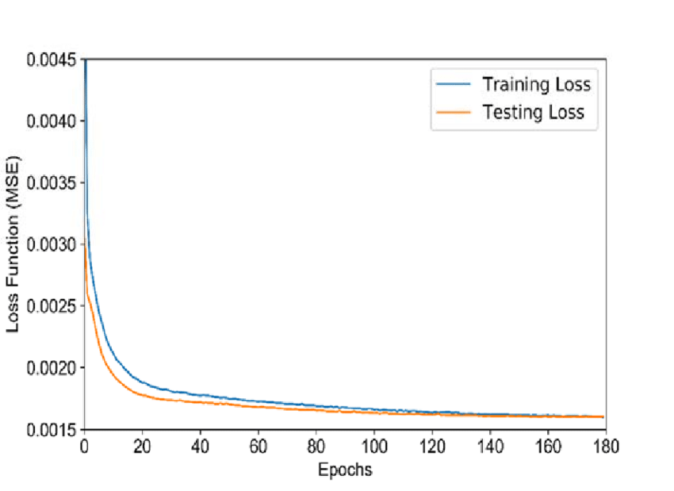
Feedforward neural network
Backpropagation
Error function (=loss) can be plotted in function of the number of epochs

Slide 32
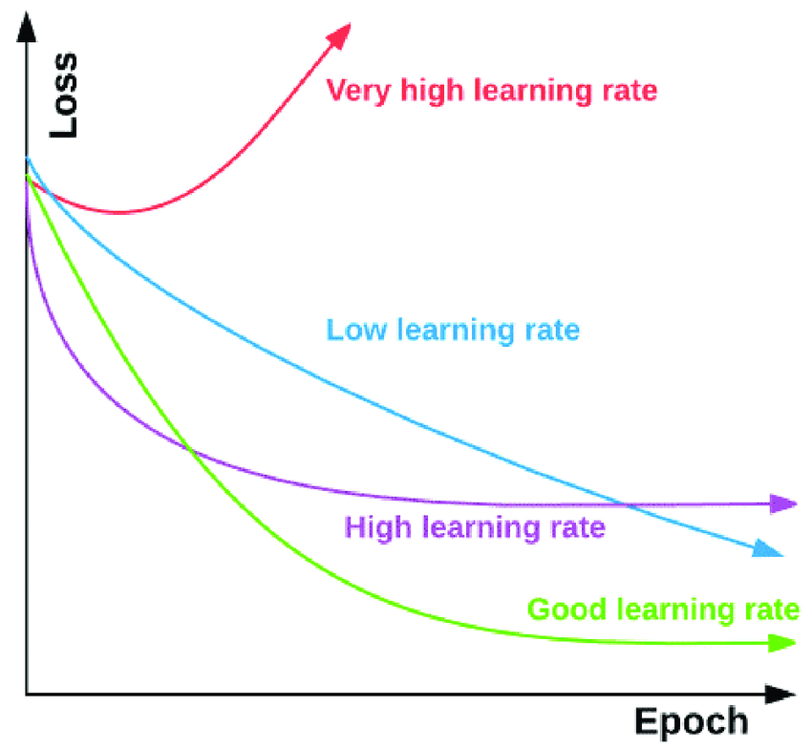
Feedforward neural network
Backpropagation
Error function (=loss) can be plotted in function of the number of epochs
Learning rate is an important hyperparameter
Often used: Adam (adaptive moment estimation)

Slide 33
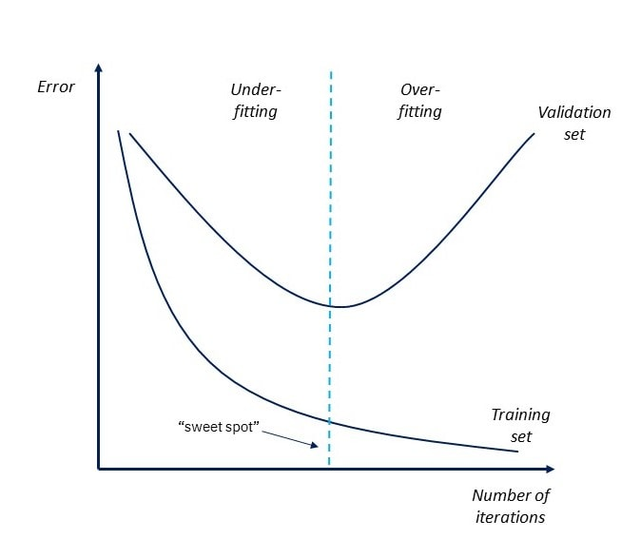
Feedforward neural network
Backpropagation
Error function (=loss) can be plotted in function of the number of epochs
Learning rate is an important hyperparameter
Often used: Adam (adaptive moment estimation)
Loss is also a nice metric to analyze overfitting

Slide 34
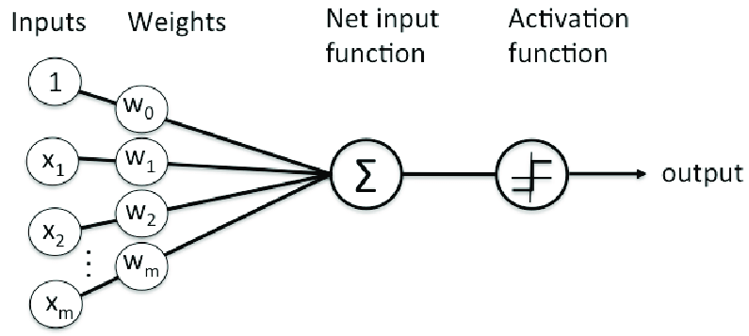
Feedforward neural network
Activation function

Slide 35
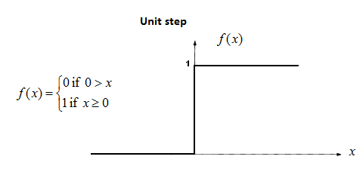
Activation function
Step function
1 if x>0 else 0
Disadvantages:
Can only return 1 or 0
Multiple classes: what if multiple 1 values?
Backpropagation won’t work (derivative = 0)

Slide 36
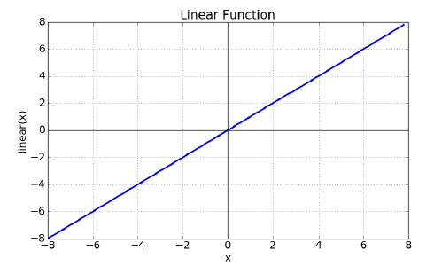
Activation function
Linear function (Adaline)
output=x
Disadvantages:
Independent of the number of layers, output will always be linear
Derivative is a constant, no link to the input
Usage:
As input layer
Output layer for regression

Slide 37
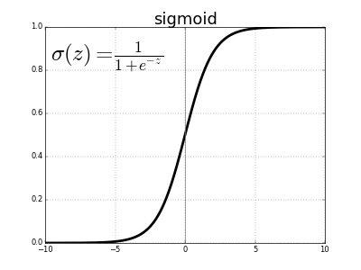
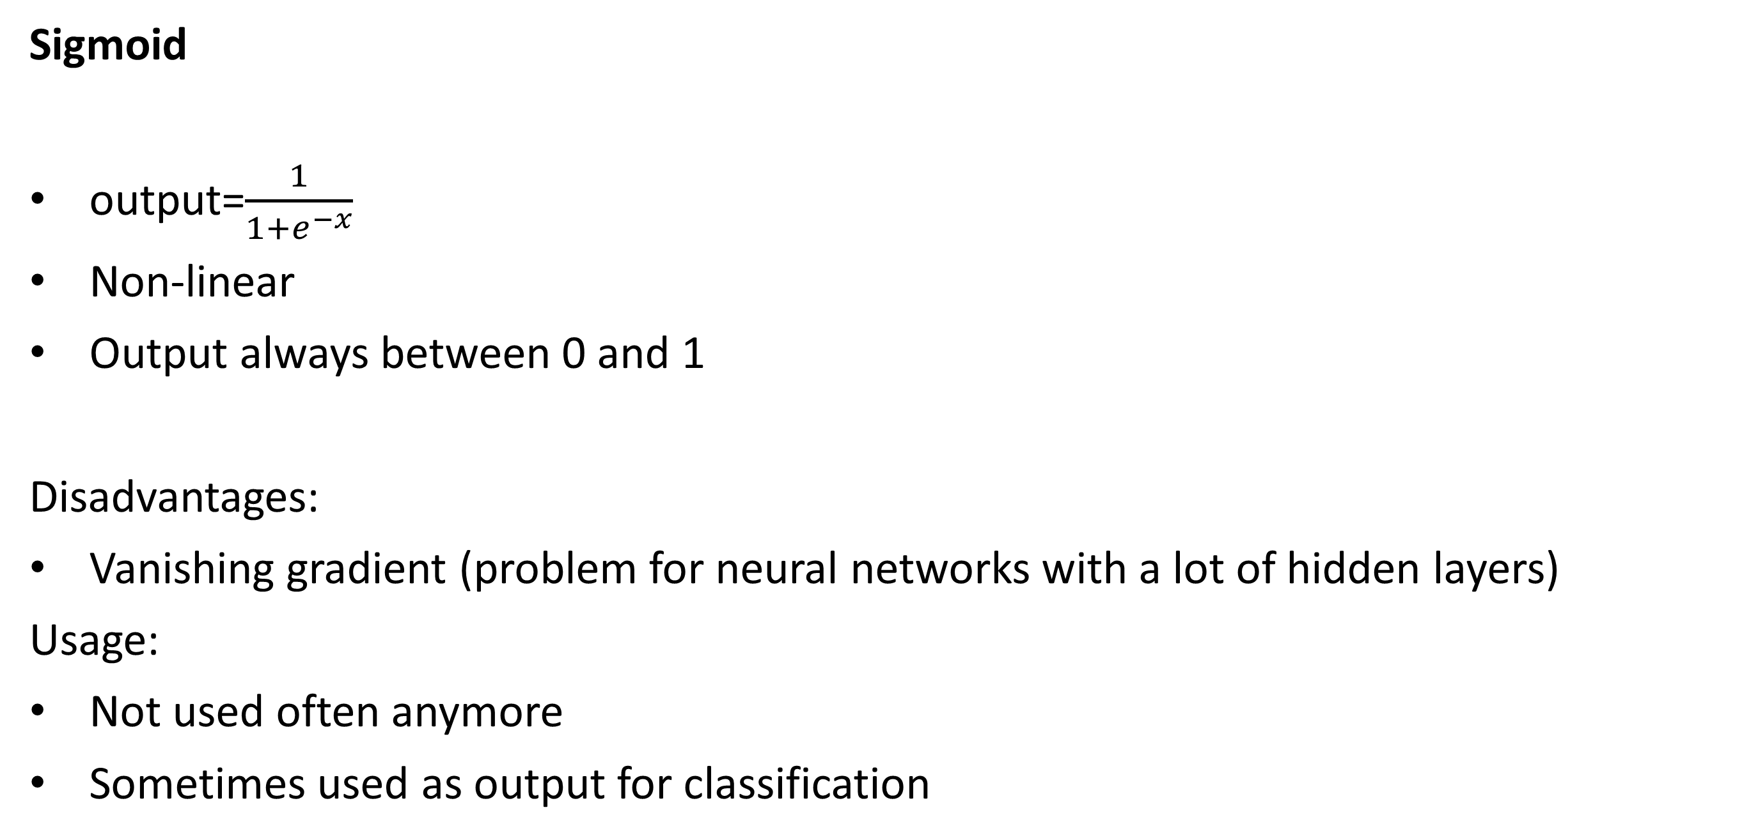
Activation function
Sigmoid
output=$\frac{1}{1+e^{−x}}$
Non-linear
Output always between 0 and 1
Disadvantages:
Vanishing gradient (problem for neural networks with a lot of hidden layers)
Usage:
Not used often anymore
Sometimes used as output for classification

Slide 38
Activation function
Hyperbolic tangent (tanh)
Non-linear
Output always between -1 and 1
Centered around 0
Disadvantages:
Vanishing gradient (problem for neural networks with a lot of hidden layers)
Usage:
Not used often anymore

Slide 39
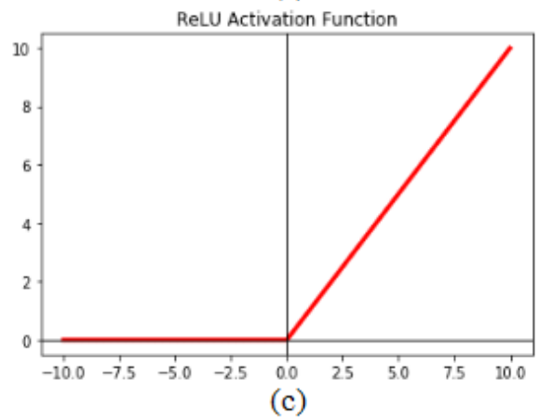
Activation function
Relu (REctified Linear Unit)
Non-linear
Each function can be approximated by a combination of Relu functions
Very efficient to calculate
x if x>0 else 0
Sparse activation (a lot of them become 0)
Disadvantages:
Dead neurons can’t be activated anymore
Usage:
Used for hidden layers

Slide 40
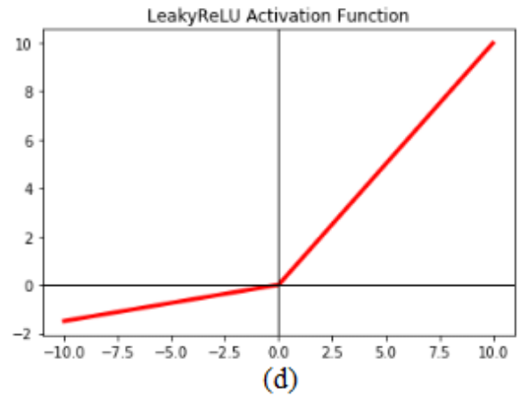
Activation function
Leaky Relu
Variaton on Relu
Does not “die”
Disadvantages:
More parameters to train
Usage:
Used for hidden layers

Slide 41
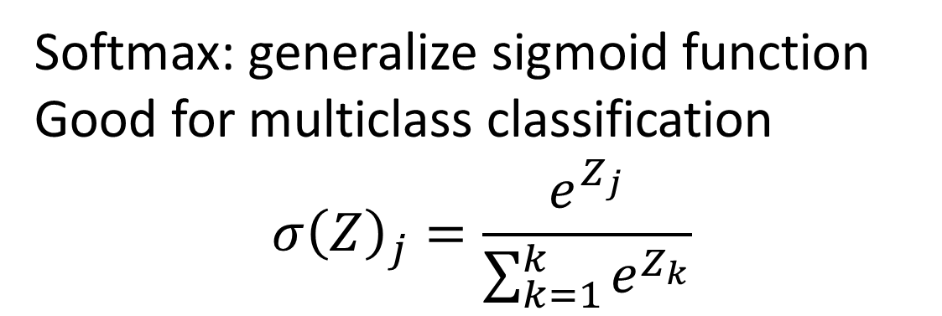
Activation function
Conclusions
Hidden layers:
First use Relu
Then try Leaky Relu
No sigmoid or tanh
Output layers:
Linear function for regression
Softmax/sigmoid for classification
Softmax: generalize sigmoid function
Good for multiclass classification
$$σ{\left(Z\right)}_{j}=\frac{e^{Z_{j}}}{\sum_{k=1}^{k}{e^{Z_{k}}}}$$

Slide 42

Under- and overfitting
Number and sizes of layers
Neural network to big: overfitting
Neural network to small: underfitting
Source: https://polakowo.io/datadocs/docs/deep-learning/regularization

Slide 43
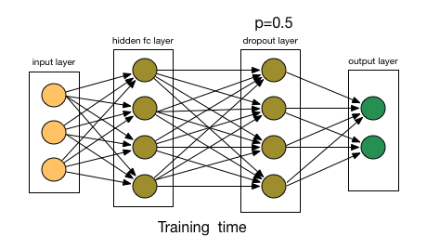
Under- and overfitting
Dropout
During training, we will randomly disable a number of nodes.
Used to prevent overfitting
Other neurons need to be able to replace the disabled neurons
=> Neurons can’t be very specific!

Slide 44


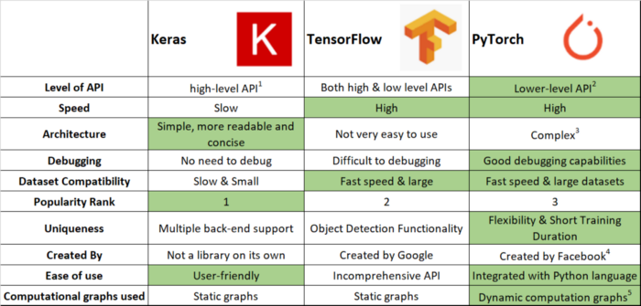
Neural networks in code
Two big players

Slide 45
Neural networks in code
Since TensorFlow 2
Keras integrated in Tensorflow
Keras (Horn in Greek: κέρας) :
Neural Network library written in python
Build on top of TensorFlow
Easy to use
Modular and extensible
Allows you to build complex neural networks more easily
"Oneiroi are beyond our unravelling - who can be sure what tale they tell? Not all that men look for comes to pass. Two gates there are that give passage to fleeting Oneiroi; one is made of horn, one of ivory. The Oneiroi that pass through sawn ivory are deceitful, bearing a message that will not be fulfilled; those that come out through polished horn have truth behind them, to be accomplished for men who see them." Homer, Odyssey 19. 562 ff (Shewring translation).

Slide 46
Tensorflow/keras
Installation
$ pip install tensorflow
(conda has an older version of tensorflow => better use pip in this case)
Keras is automatically installed as well!

Slide 47
Tensorflow/keras
The sequential model
A sequential model allows you to stack multiple layers on top of one another
https://keras.io/about/#first-contact-with-keras
Initializing a model:
Add new layers:
784 inputs, 64 hidden layer Relu units, 10 softmax outputs
from tensorflow.keras.models import Sequential
model = Sequential()
from tensorflow.keras.layers import Dense
model.add(Dense(units=64, activation='relu', input_dim = 784))
model.add(Dense(units=10, activation='softmax'))

Slide 48
Tensorflow/keras
The sequential model
Compilation
Training
Predict
model.compile(loss='categorical_crossentropy',
optimizer='sgd',
metrics=['accuracy'])
model.compile(loss=keras.losses.categorical_crossentropy,
optimizer=keras.optimizers.SGD(
learning_rate=0.01,
momentum=0.9, nesterov=True
)
)
model.fit(x_train, y_train, epochs=5, batch_size=32)
classes = model.predict(x_test, batch_size=128)

Slide 49
Tensorflow/keras hyperparameters
Activation functions
https://keras.io/api/layers/activations/
Some available built-in functions
Softmax
Relu
Sigmoid
Tanh
Linear (= no activation function)
More advanced functions:
Leaky Relu

Slide 50
Tensorflow/keras hyperparameters
Learning rate optimizers
https://keras.io/api/optimizers/
Built-in optimizers:
https://keras.io/api/optimizers/#available-optimizers
SGD (+ nesterov)
Stochastic gradient descent with (nesterov) momentum
RMSProp
Better for recurrent neural networks
Adagrad
Adam
Adamax
…

Slide 51
Tensorflow/keras hyperparameters
Terminology
Epochs
The number of times a neural network gets to see the full training data
Batch_size
The number of samples the NN gets to see before it updates its weight.
Updating is done by the average error on the batch
Iterations
The total number of times the weights are updated.
= epochs * #batches
model.fit(x_train, y_train, epochs=5, batch_size=32)

Slide 52
Tensorflow/keras hyperparameters
Terminology
Batch mode
Batch size = the number of training samples
All training data is used before updating the weights
Mini-batch mode
Batch size > 1 and < #samples
Stochastic mode
Batch size == 1
Update the training data after each training sample
model.fit(x_train, y_train, epochs=5, batch_size=32)

Slide 53
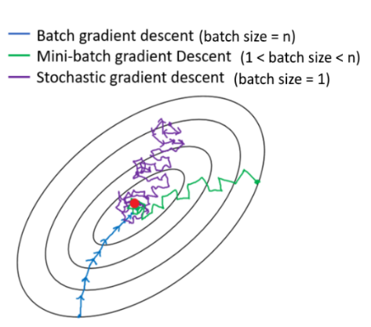
Tensorflow/keras hyperparameters
Batch size
Advantages of a small batch size
Less memory usage
Learns faster than big batch sizes
Faster feedback for the model
Disadvantages
Less accurate prediction of gradient (gradient is based on last few training samples)
Why not always use full training data as a batch?
Memory isues

Slide 54
Tensorflow/keras hyperparameters
Loss function
https://keras.io/api/losses/#available-losses
Error functions used during training
Error losses for regression
mean_squared_error(y_true,y_pred)
mean_absolute_error(y_true,y_pred)
mean_squared_logarithmic_error(y_true,y_pred)
mean_absolute_percentage_error(y_true,y_pred)

Slide 55
Tensorflow/keras hyperparameters
Loss function
https://keras.io/api/losses/#available-losses
Error functions used during training
Error losses for classification
binary_crossentropy(y_true,y_pred)
For multilabel classification (for example a picture with both a dog and a cat)
categorical_crossentropy(y_true,y_pred)
Multiclass classification (for example MNIST)

Slide 56
Tensorflow/keras hyperparameters
Metrics
https://keras.io/api/metrics/#available-metrics
Regression
Mean squared error
mean_squared_error (or mse)
Mean absolute error
mean_absolute_error (or mae)
Mean absolute percentage error
mean_absolute_percentage_error (or mape)
Cosine proximity
cosine

Slide 57
Tensorflow/keras hyperparameters
Metrics
https://keras.io/api/metrics/#available-metrics
Classification
Binary accuracy
binary_accuracy
Categorical accuracy
categorical_accuracy
Top k categorical accuracy
top_k_categorical_accuracy
Precision
Recall
AUC

Slide 58
Tensorflow/keras hyperparameters
Metrics
You can specify multiple metrics
During training you can display the scores:
model.compile(loss="binary_crossentropy",
optimizer='adam',
metrics=['accuracy','Precision','AUC'])
Epoch 2/100 198/198 [==============================] - 7s 37ms/step - loss: 0.5771 - accuracy: 0.7045 - precision: 0.7045 - auc: 0.7725 - val_loss: 1.1330 - val_accuracy: 0.4406 - val_precision: 0.4406 - val_auc: 0.6021
Epoch 3/100 198/198 [==============================] - 7s 38ms/step - loss: 0.3342 - accuracy: 0.8637 - precision: 0.8637 - auc: 0.9338 - val_loss: 0.3497 - val_accuracy: 0.8494 - val_precision: 0.8494 – val_auc: 0.9266

Slide 59
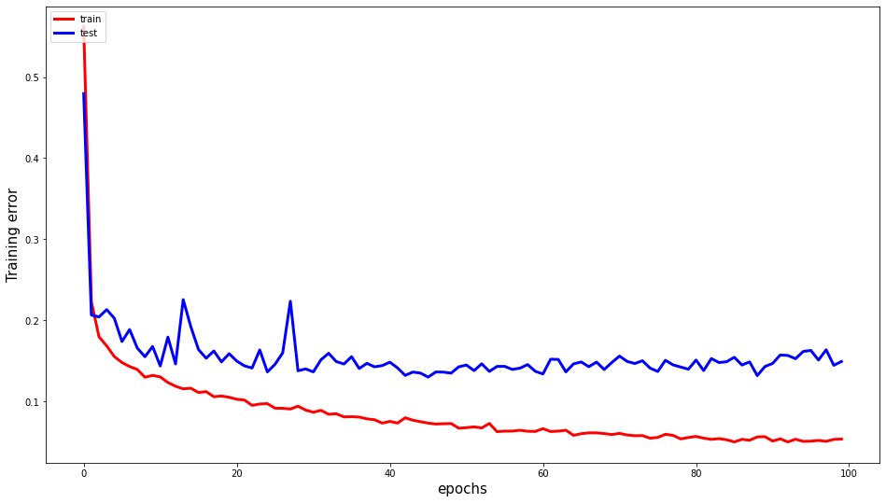
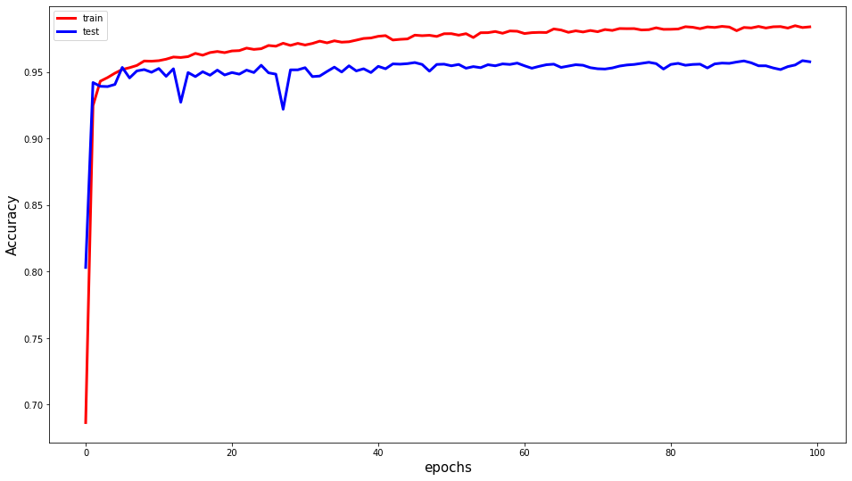
Tensorflow/keras hyperparameters
Metrics
You can also plot them

Slide 60
Tensorflow/keras hyperparameters
Other parameters
Validation_split: fraction of training data used for validation
Comparable to K-fold validation
Sample_weight_mode
For unbalanced data

Slide 61
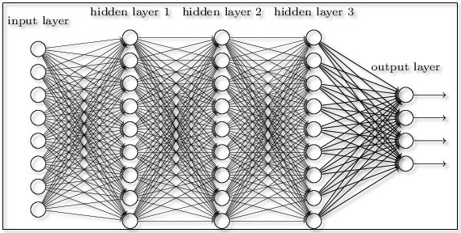
Other architectures
Feed forward neural network
Supervised learning where data is not sequential or time-dependent
Data does not need to be in a particular order
Informational

Slide 62
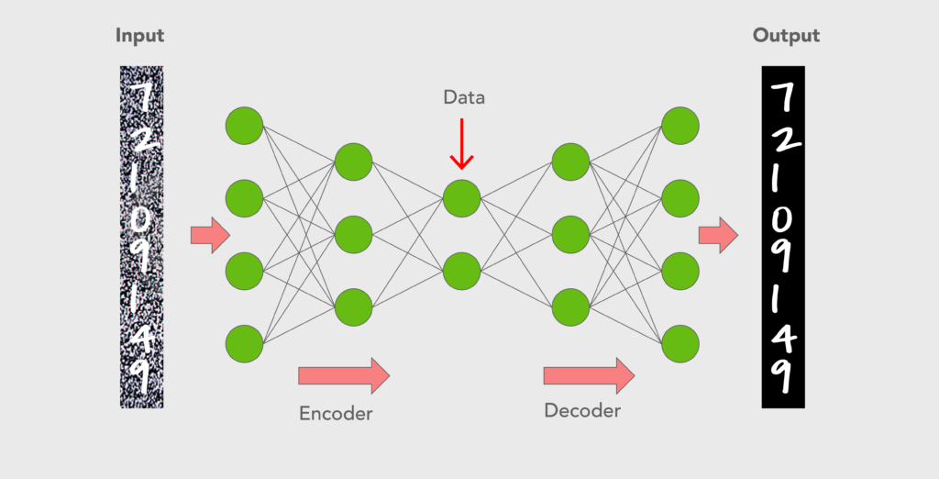
Other architectures
Autoencoders
Unsupervised learning
Compress data
Denoise data
Detect outliers
Fill in missing data
Exists out of a
Encoder
Decoder
Expected output = input
Informational

Slide 63
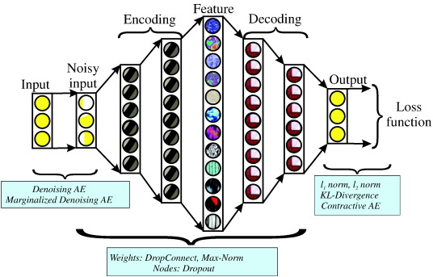
Other architectures
Autoencoders
Other special types exist
Variational autoencoders
Sparse autoencoders
A sparse autoencoder
Informational

Slide 64
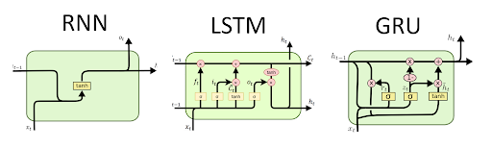
Other architectures
Recurrent neural networks
Good for time series data (sequential data)
Basic RNN
Has a vanishing gradient problem
Long Short-Term Memory network (LSTM)
Computationally expensive
Gated Recurrent Unit (GRU)
Less computationally expensive
E.g., text processing, sound analysis
https://stanford.edu/~shervine/teaching/cs-230/cheatsheet-recurrent-neural-networks
Informational

Slide 65
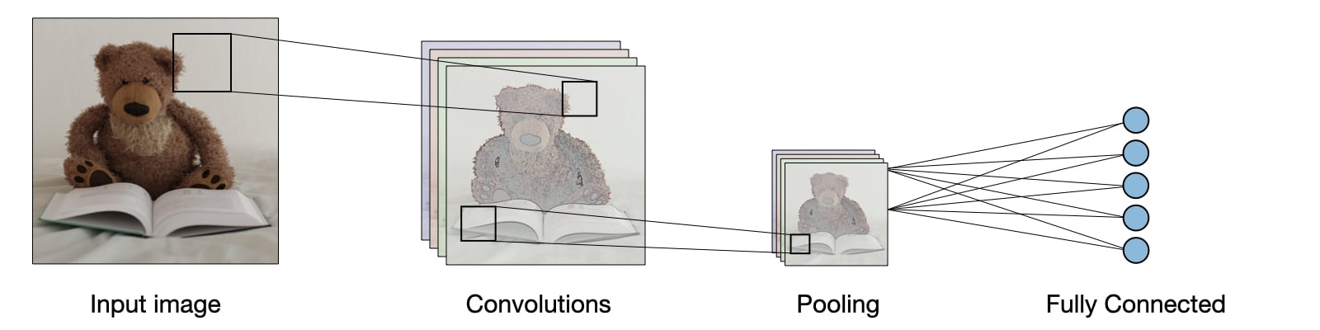
Other architectures
Convolutional neural networks
Heavily used for image analysis
Convolutions
Kind of ‘filters’ on subsets of the data (regions of the data)
=> Not all inputs from previous layer are connected to the neurons in the following layer
For example: a neuron in the next layer could be based on only a 3x3 grid of values from previous layer => 9 inputs for the layer instead of #pixels
Multiple ‘filters’ can be created per layer
Pooling
Make a smaller set of features from the previous layer (e.g., 100x100 -> 50x50)
Flatten
Before going to a fully connected network => convolutions need to be transformed into a ‘flat’ layer (fully connected is needed for the final predictions)
Informational

Slide 66
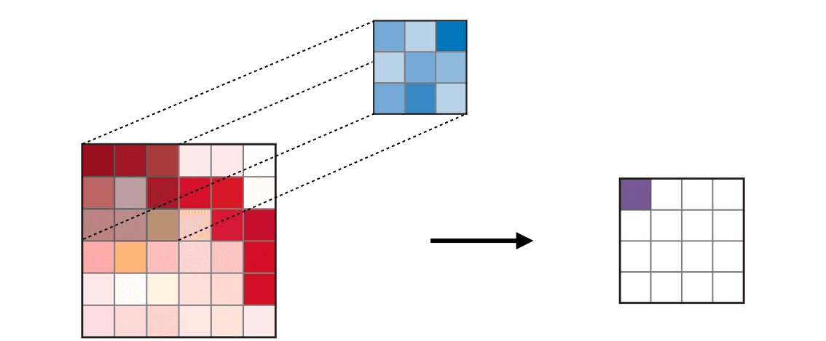
Other architectures
Convolutional neural networks
Convolution
Informational

Slide 67
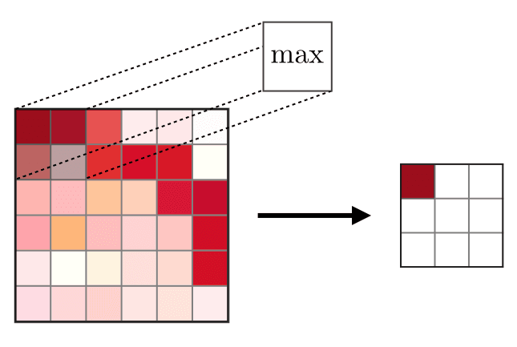
Other architectures
Convolutional neural networks
Pooling
Max pooling
Average pooling
…
Informational

Slide 68
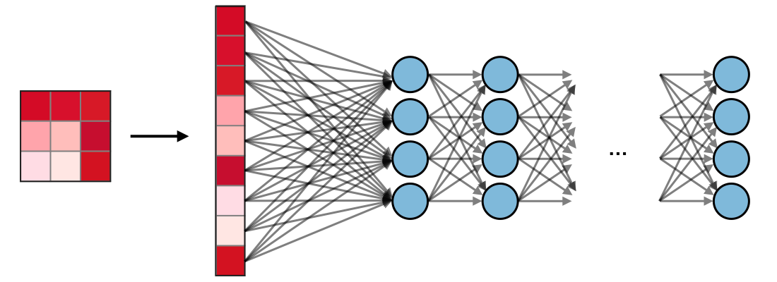
Other architectures
Convolutional neural networks
Flatten
Informational

Slide 69

Other architectures
Generative Adversarial Neural Networks (GANN)
Generate new data indistinguishable of real data
Deepfakes
2 Neural networks that are in competition with each other
Generator
Creates new data that should look like real data
Discriminator
Predicts if data is real or not
Informational

Slide 70
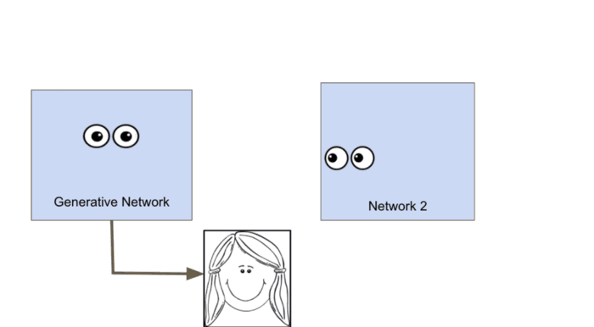
Other architectures
Generative Adversarial Neural Networks (GANN)
The networks train independently
First the generator trains to trick the discriminator
When the generator does a good job, it stops training
Now the discriminator starts training until it is good at deciding if the data is real or not
Repeat
Informational

Slide 71
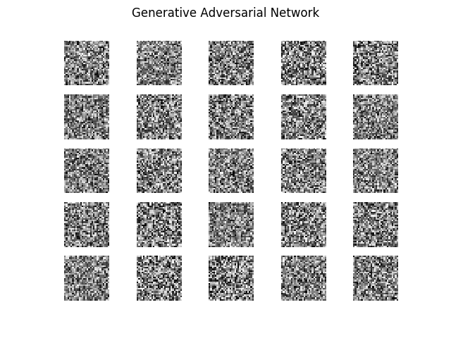
Other architectures
Generative Adversarial Neural Networks (GANN)
Informational

